Slide 1
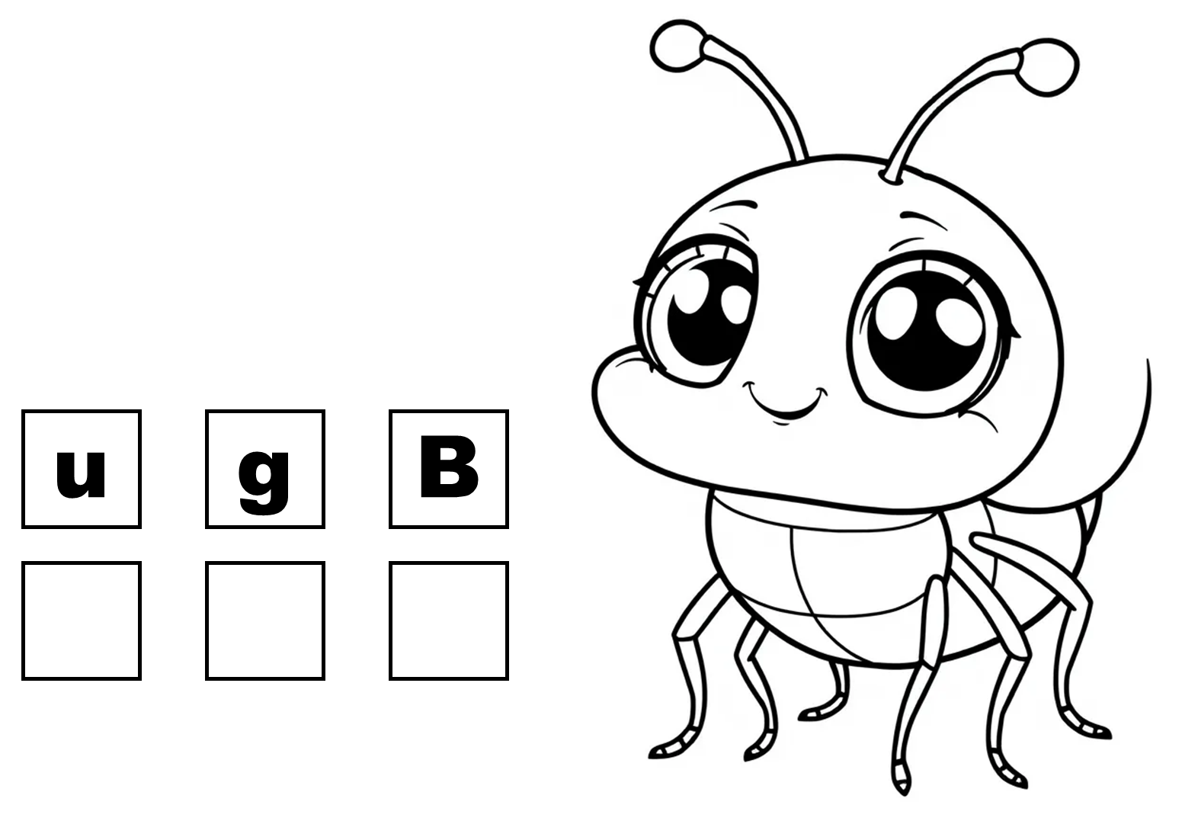
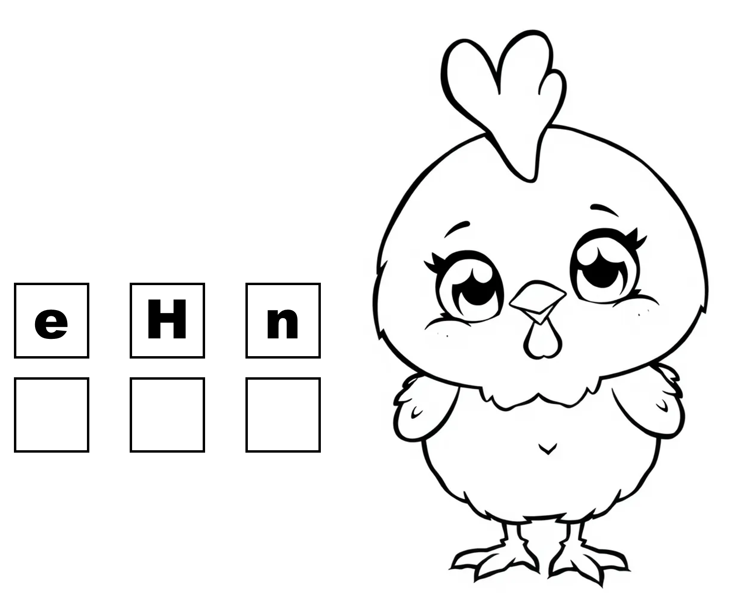
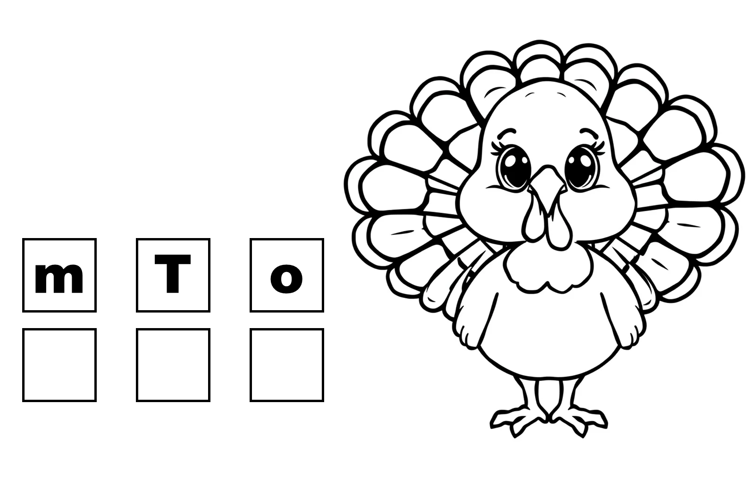
Unscramble CVC
Coloring Workbook

Slide 2
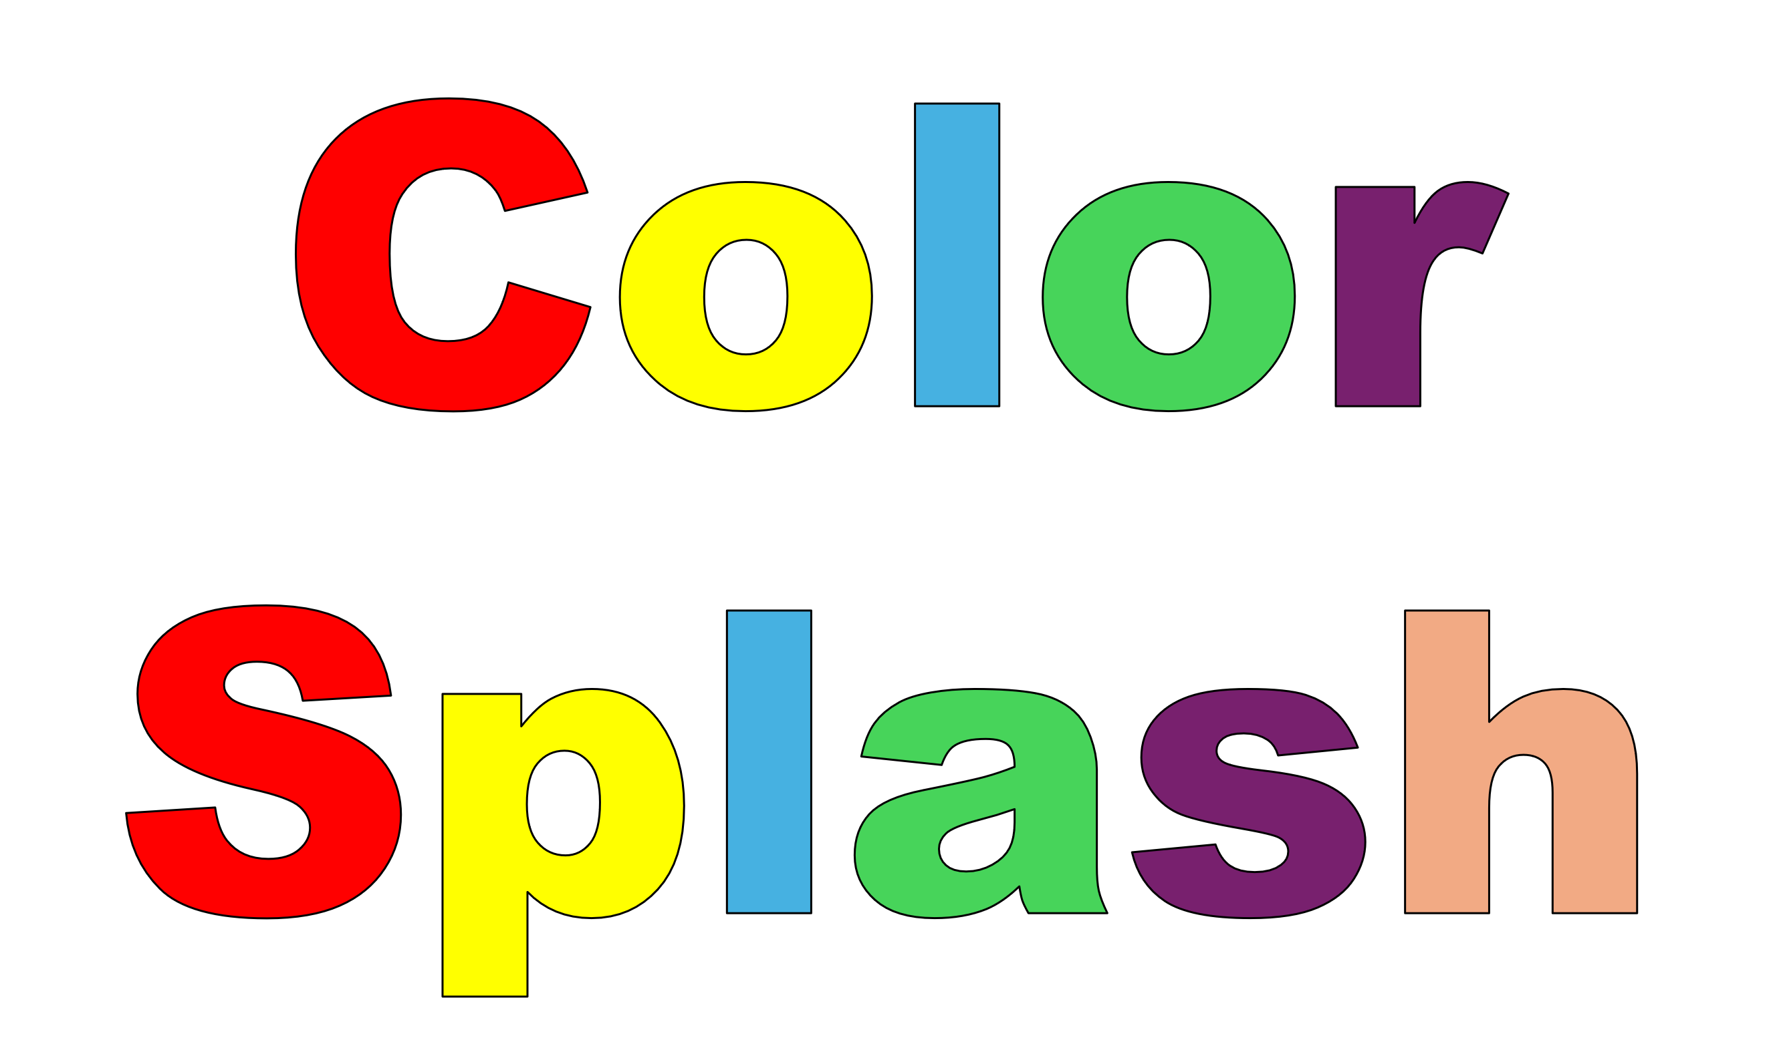
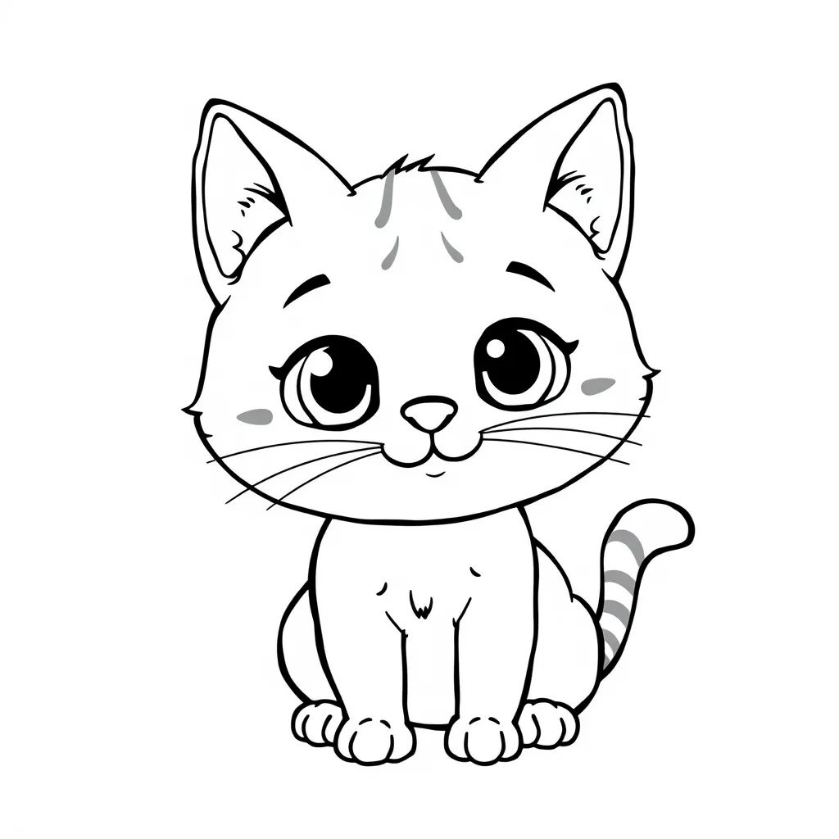
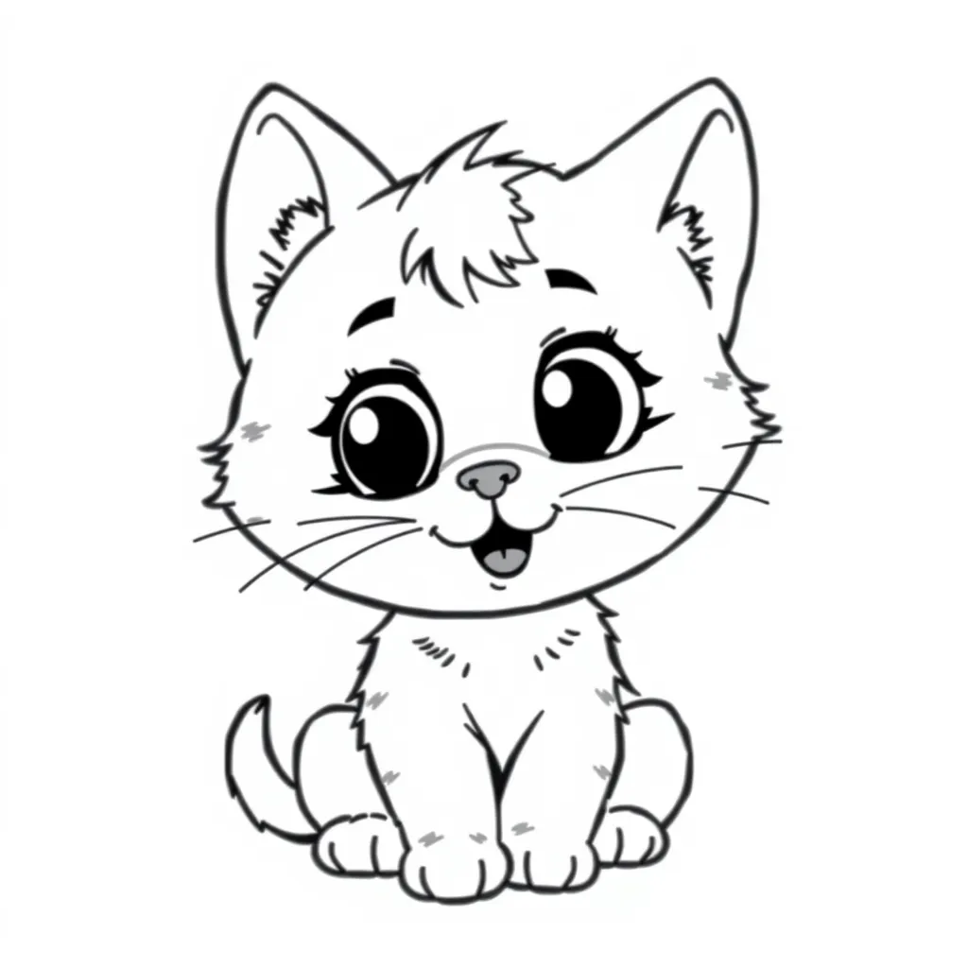
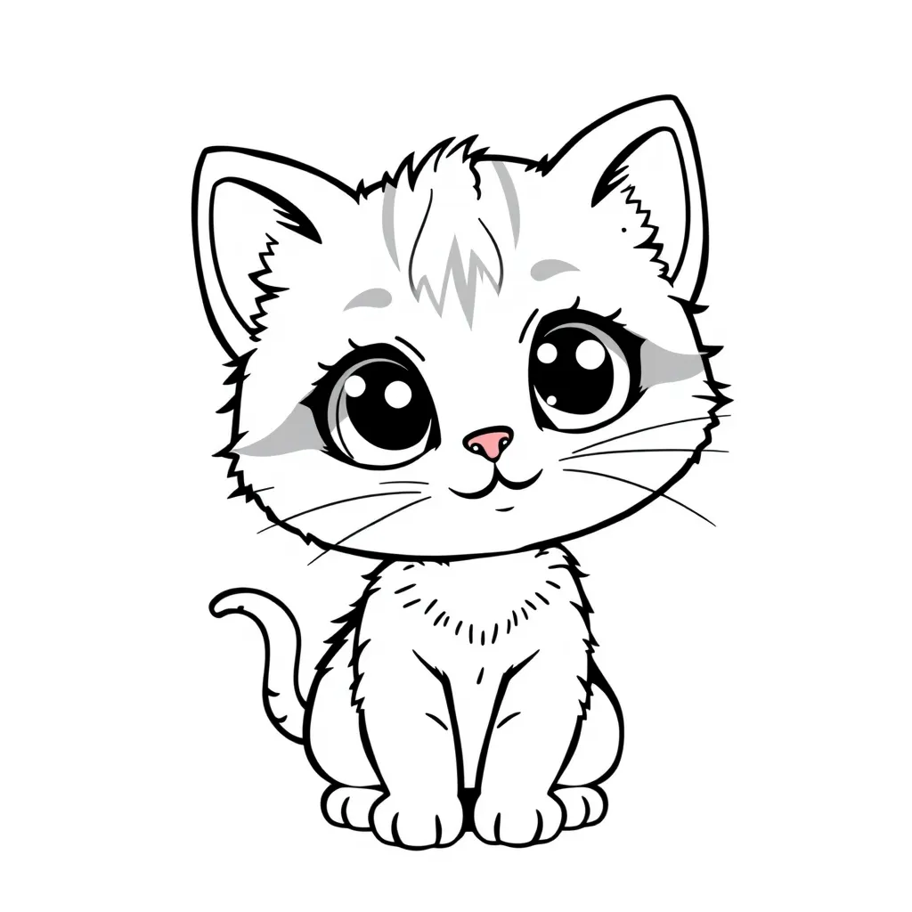
Blossomings.github.io
Color Splash
t
C
a

Slide 3
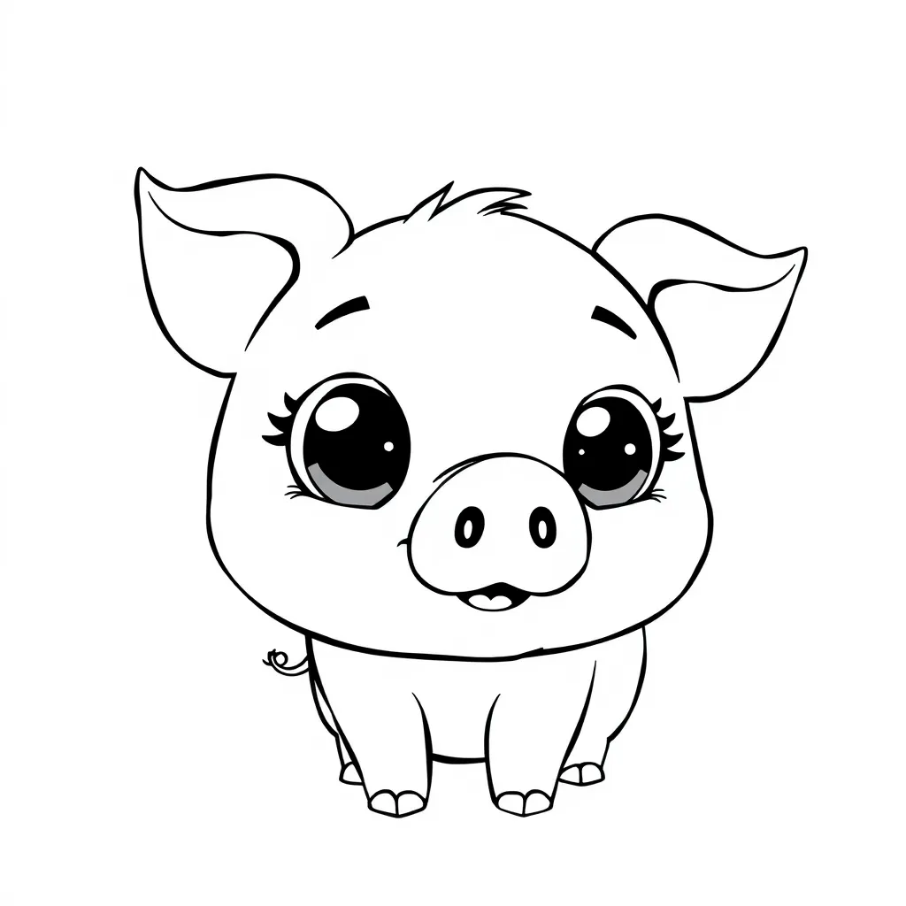
Blossomings.github.io
Color Splash
i
g
P

Slide 4
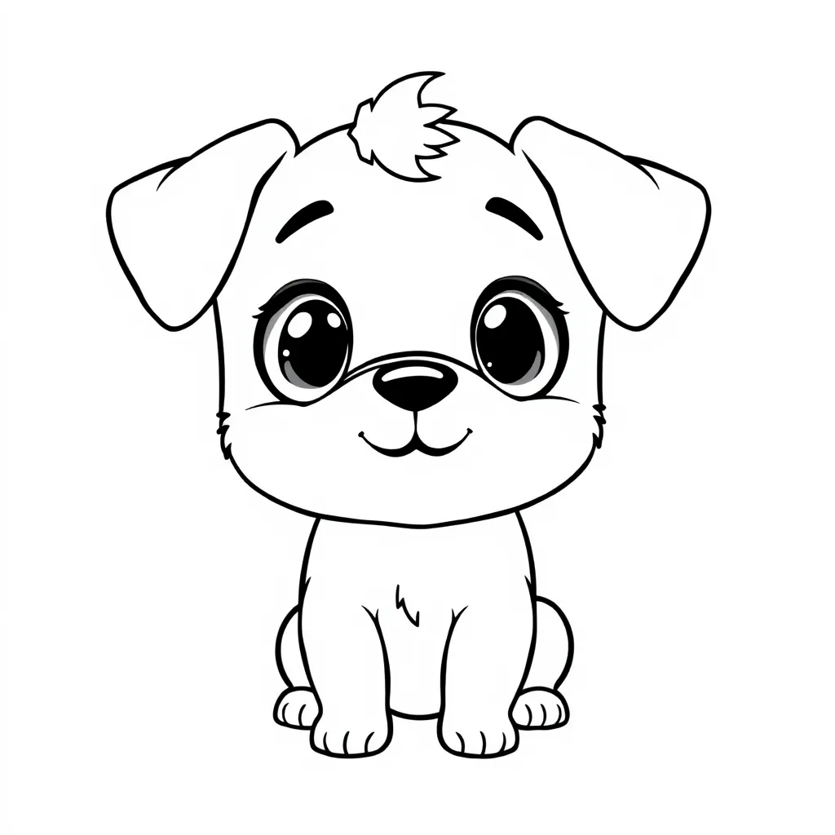
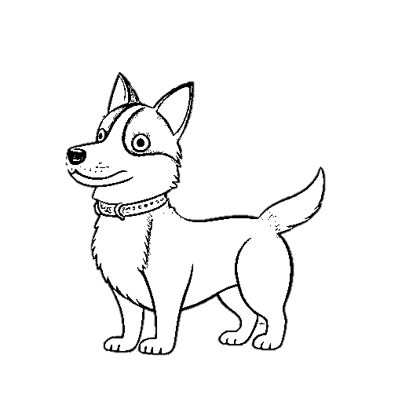
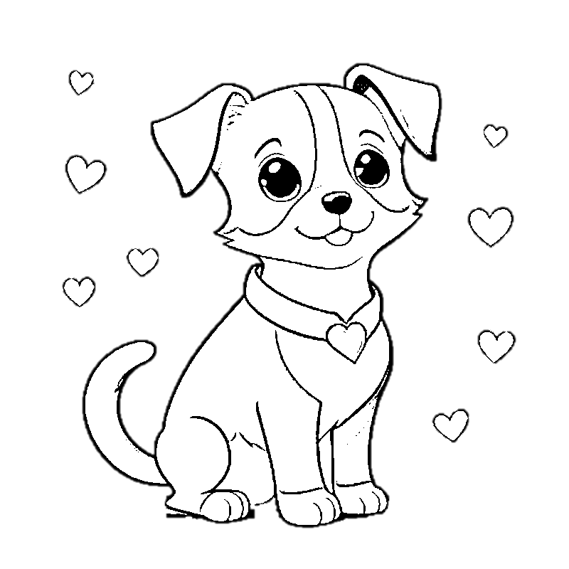
Blossomings.github.io
Color Splash
t
e
P

Slide 5

Blossomings.github.io
Color Splash
a
r
C

Slide 6
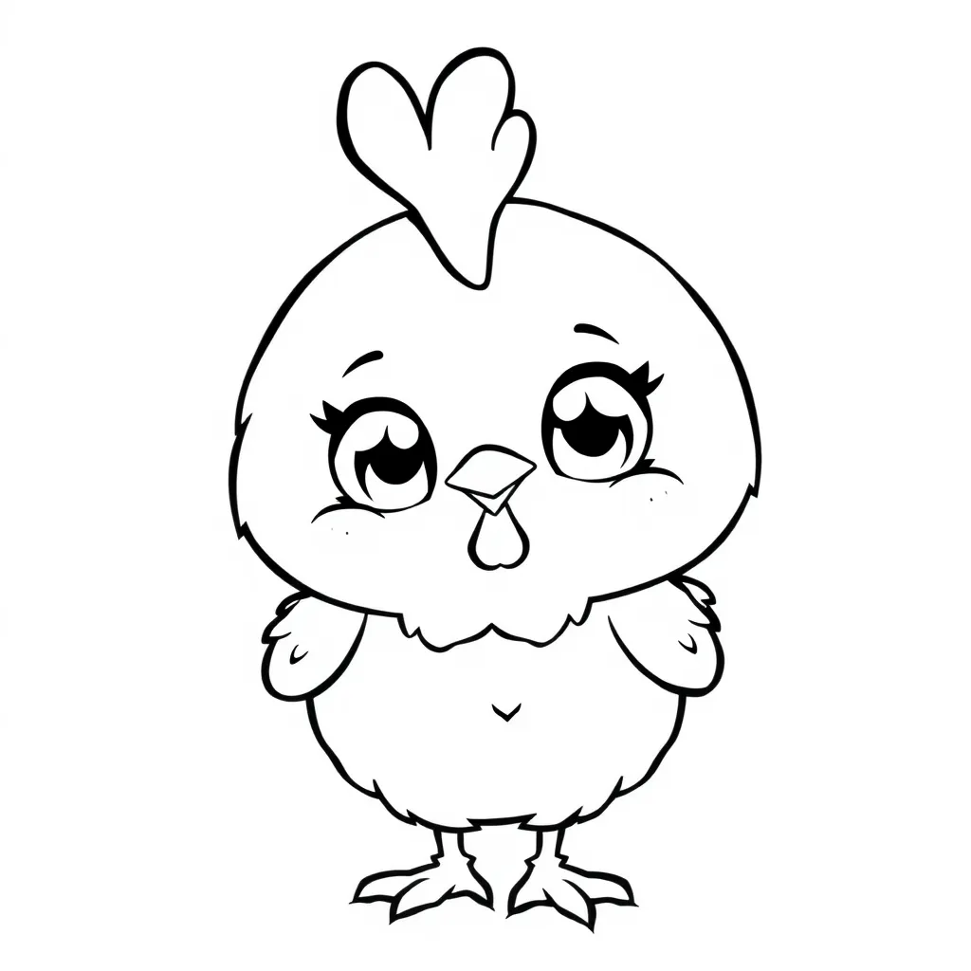
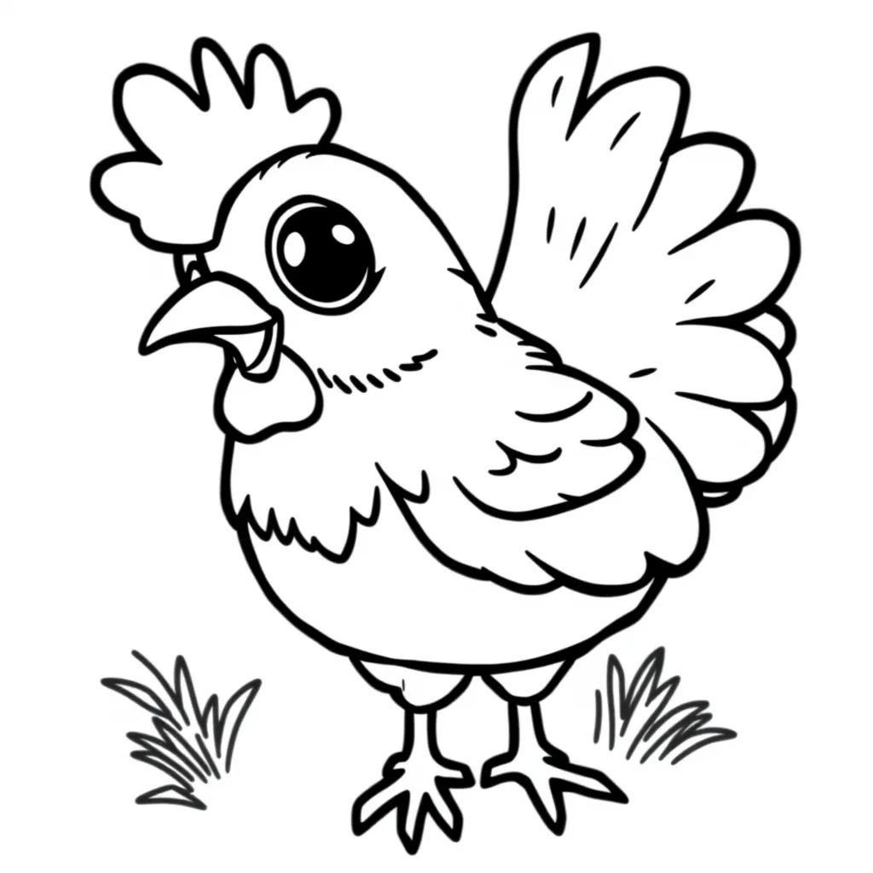
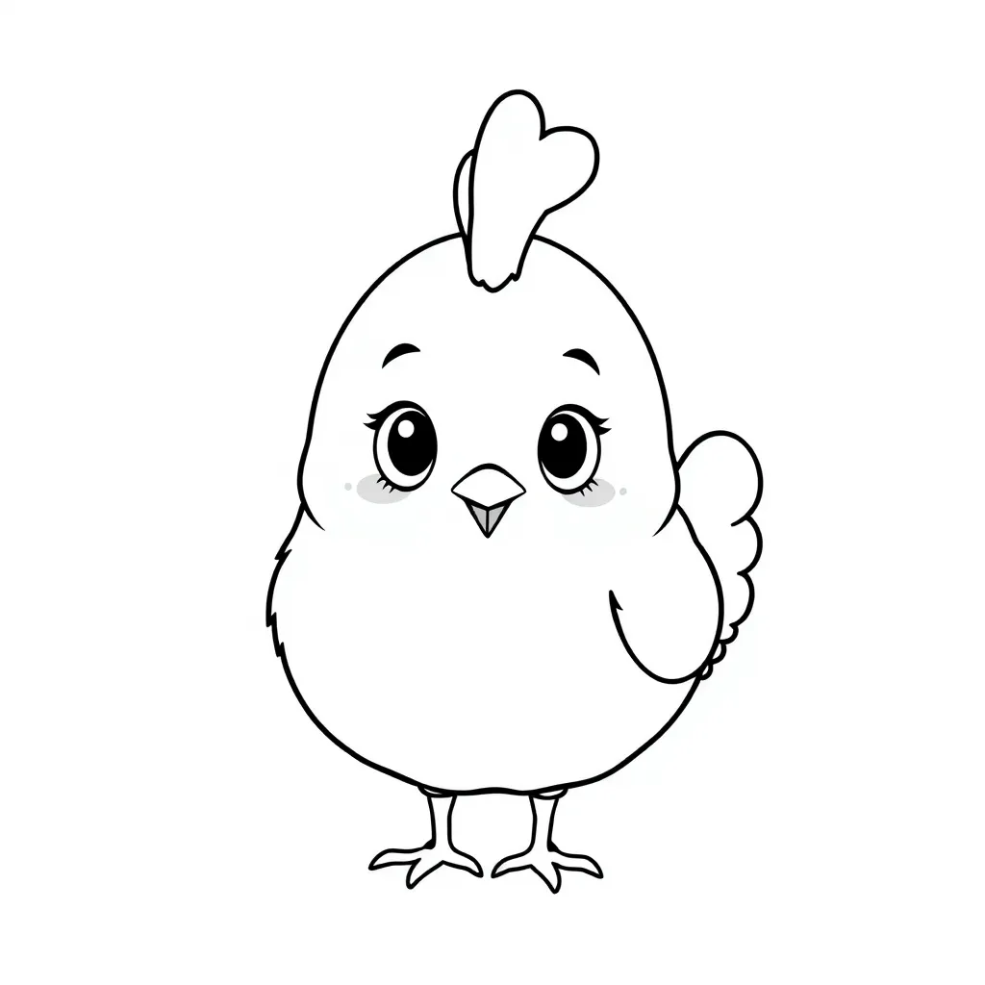
Blossomings.github.io
Color Splash
e
H
n

Slide 7
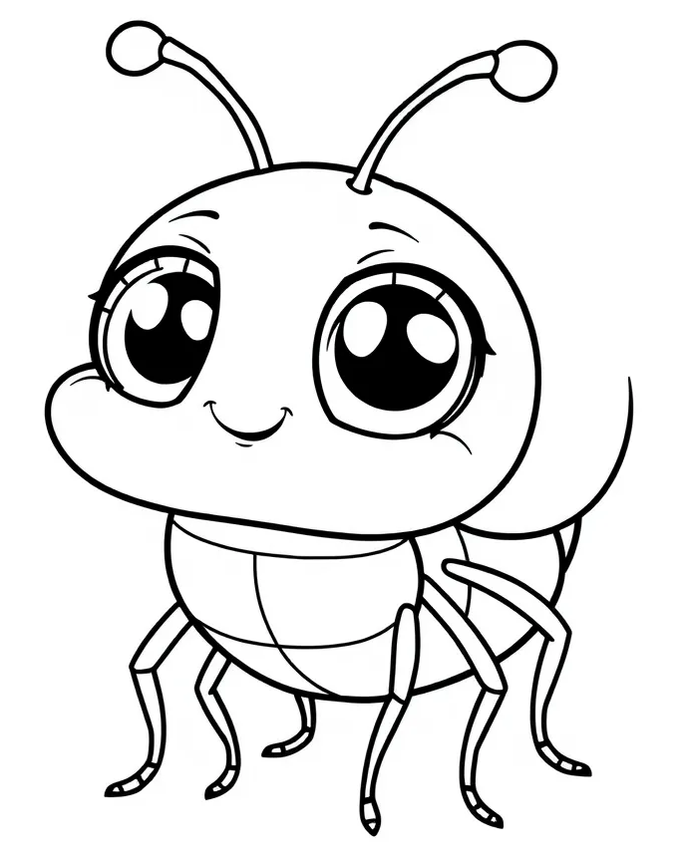
Blossomings.github.io
Color Splash
u
g
B

Slide 8
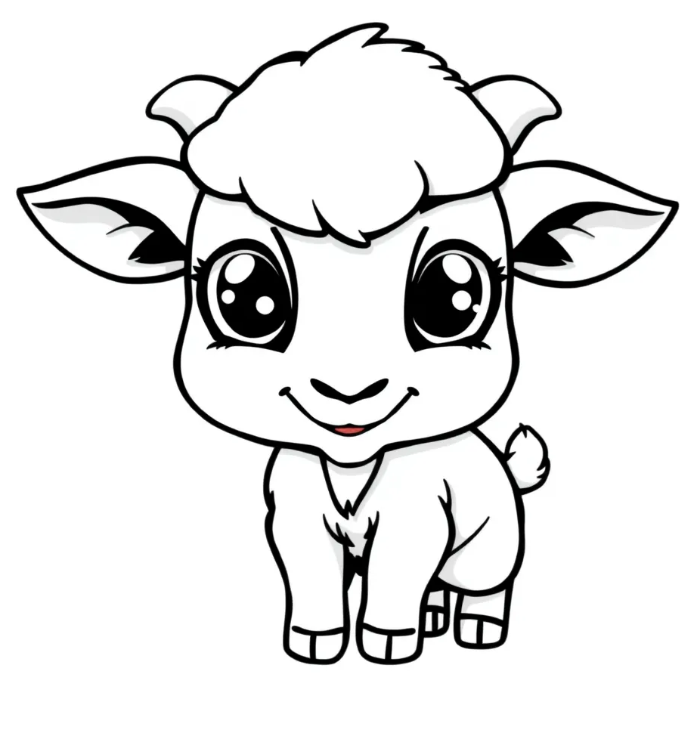
Blossomings.github.io
i
d
K
Color Splash

Slide 9


Blossomings.github.io
Color Splash
g
D
o

Slide 10
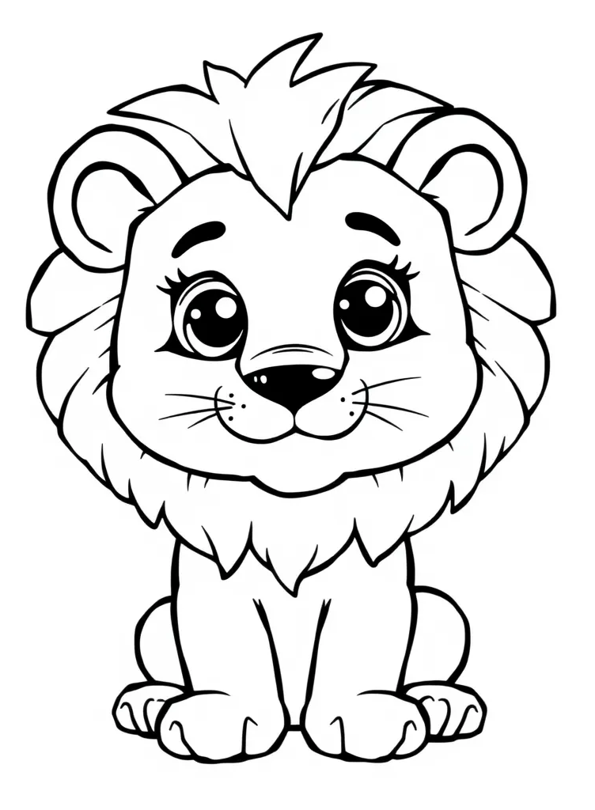
Blossomings.github.io
Color Splash
u
C
b

Slide 11
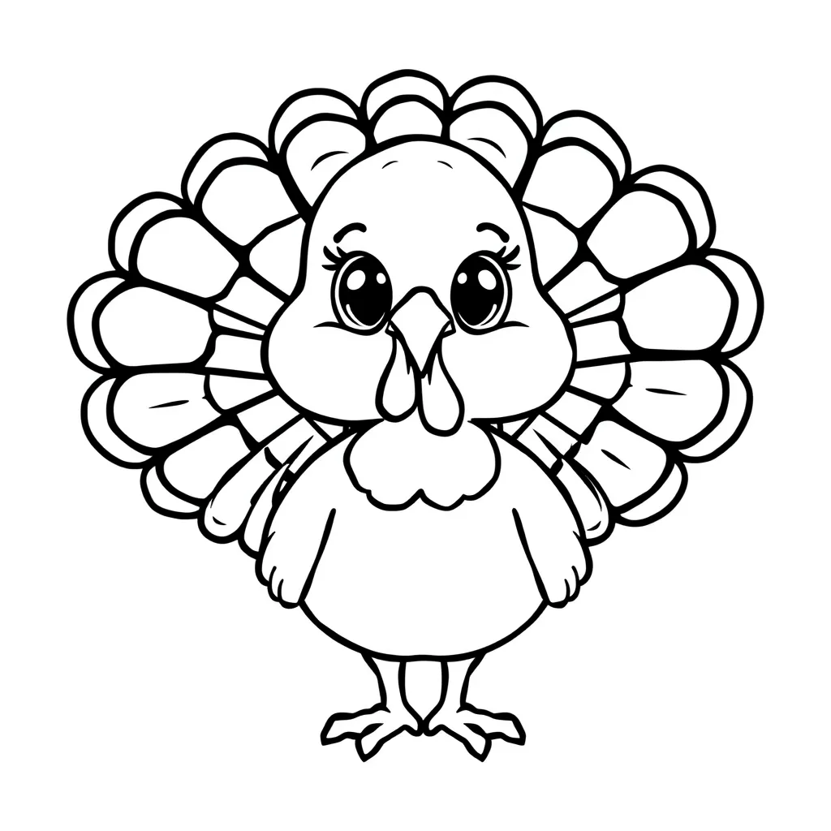
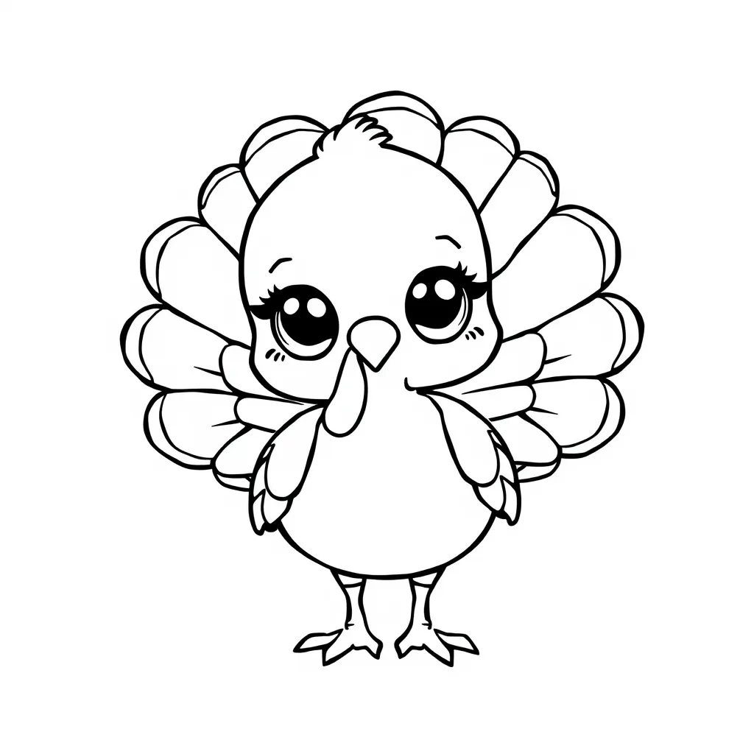
Blossomings.github.io
Color Splash
m
T
o

